Slide 1


Welcome to Rosegrove Infant School
Early Years Foundation Stage

Slide 2
We can’t wait to meet you!
We are very excited that you are starting school and we are sure that you are looking forward to coming to Rosegrove Infant School.
Here is a little bit of information for children and parents about our school and classroom environments.

Slide 3
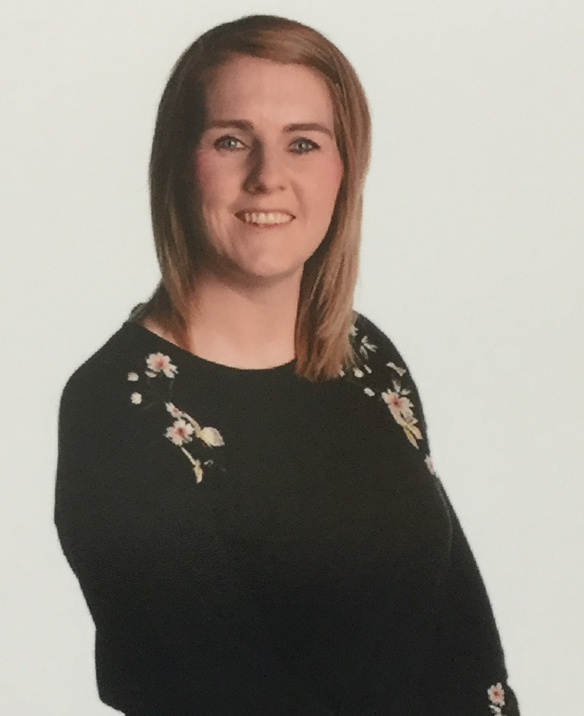
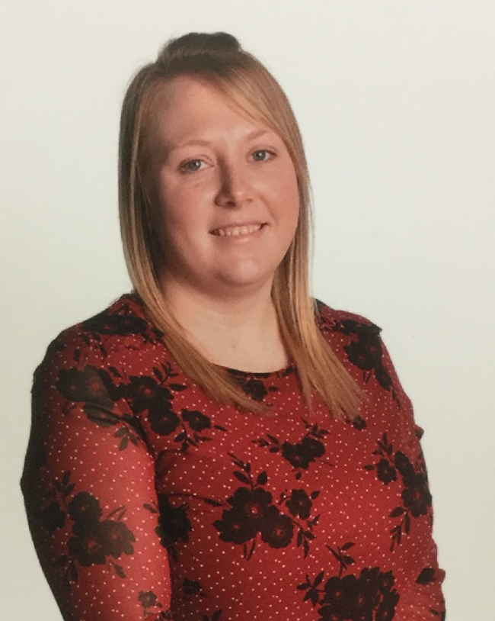
We have two Reception classes!
Pearl class teacher is
Miss Wilson
Topaz class teacher is
Mrs Hudson

Slide 4
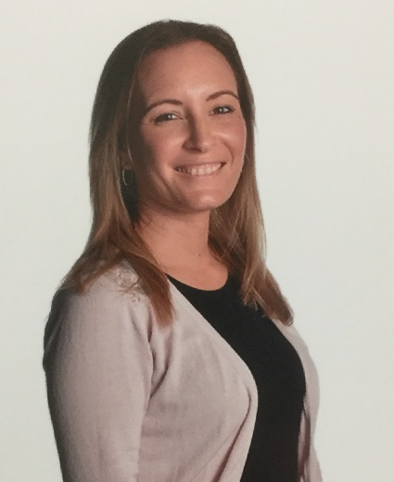
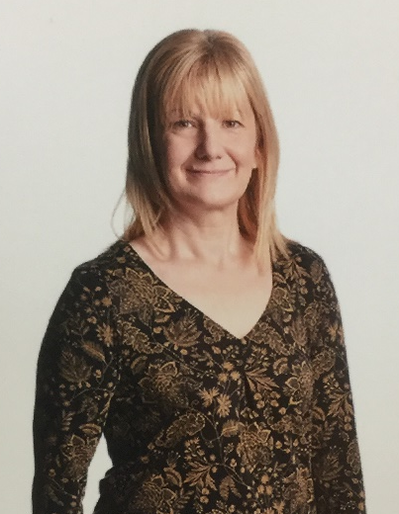
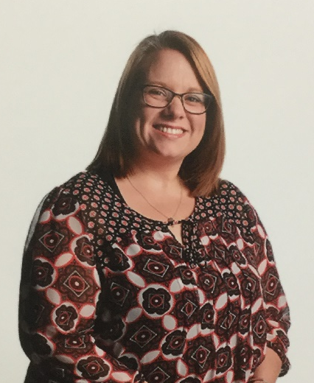
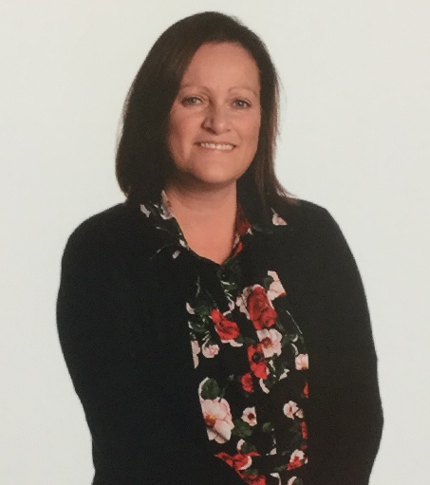
Here are the Reception class teaching assistants, we have two based in each classroom.
Mrs Irvine
Mrs Atkinson
Mrs Willcocks
Miss Mitchell

Slide 5
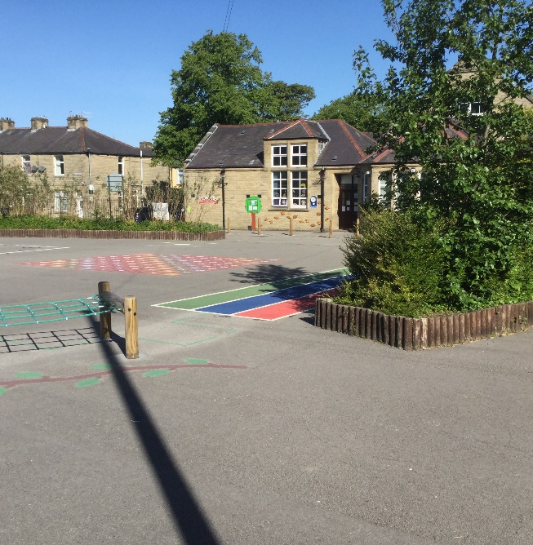
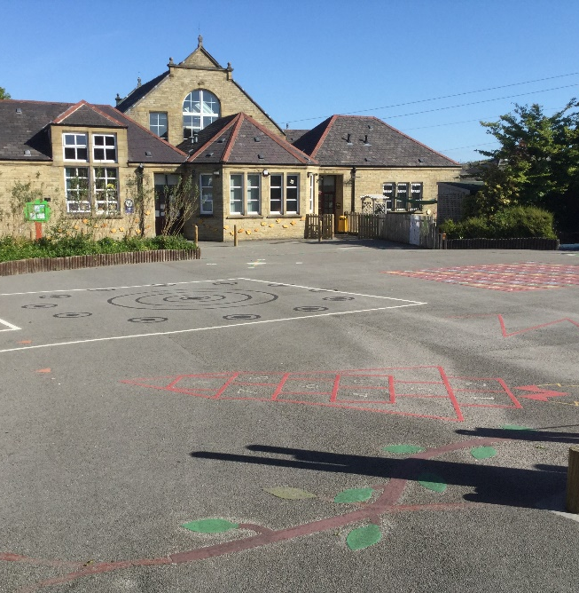
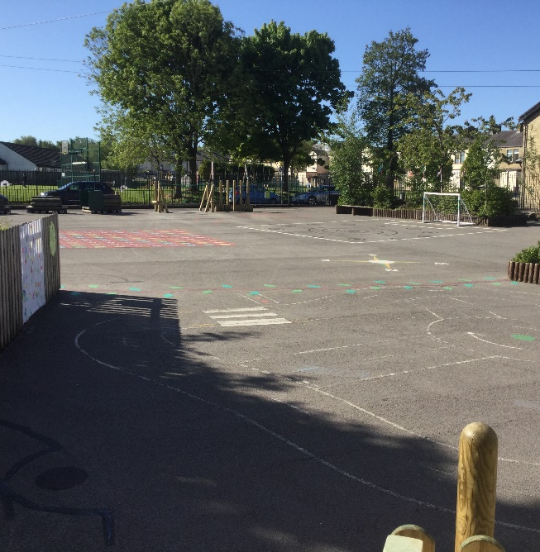
Our School

Slide 6
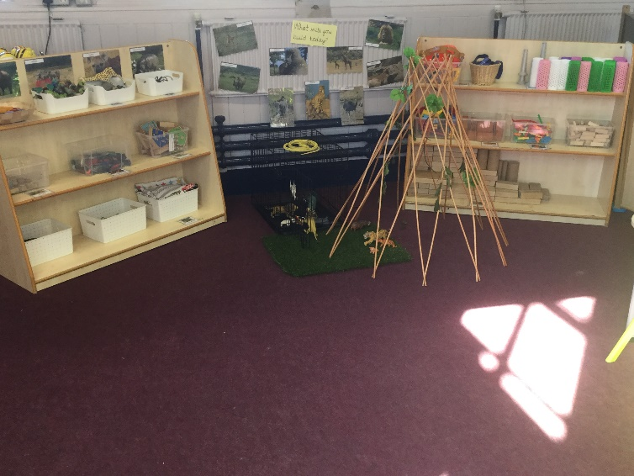
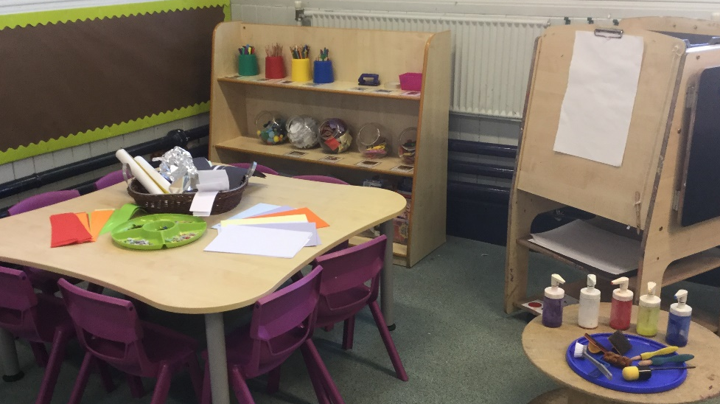
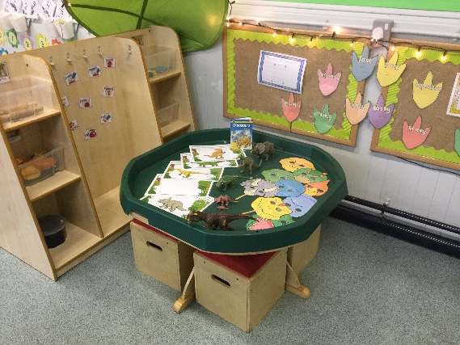
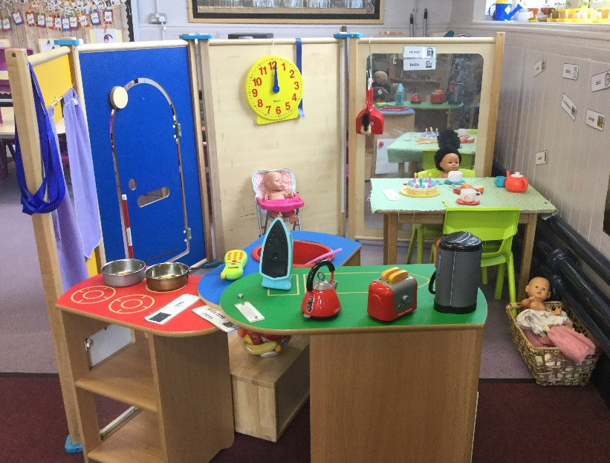
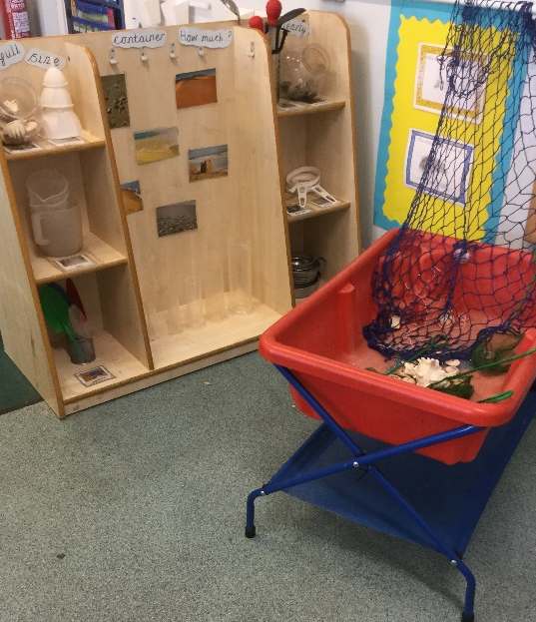
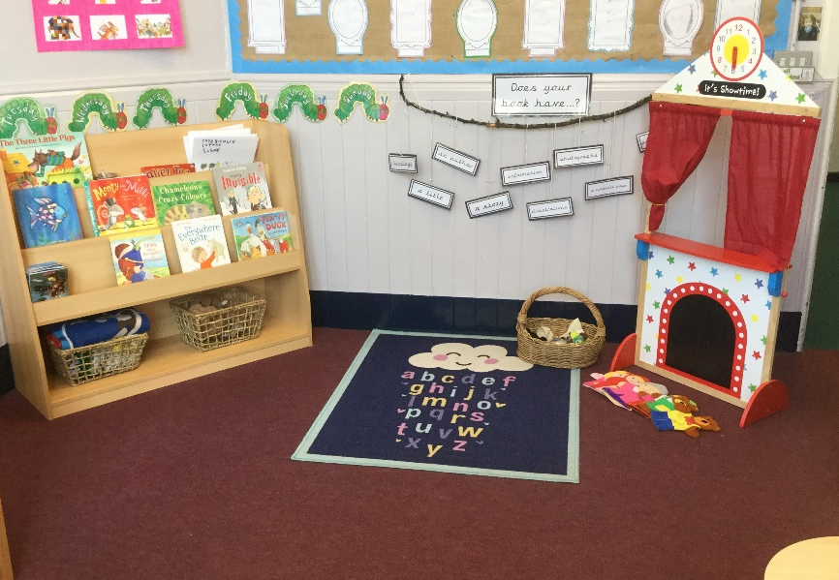
Our Indoor Environment

Slide 7
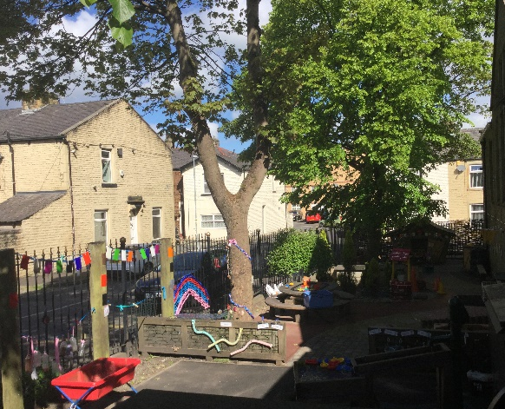
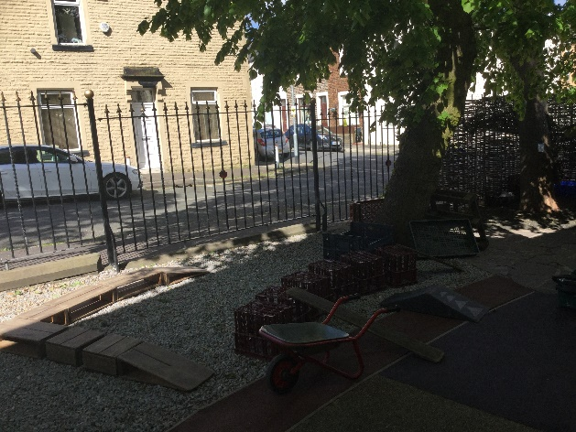
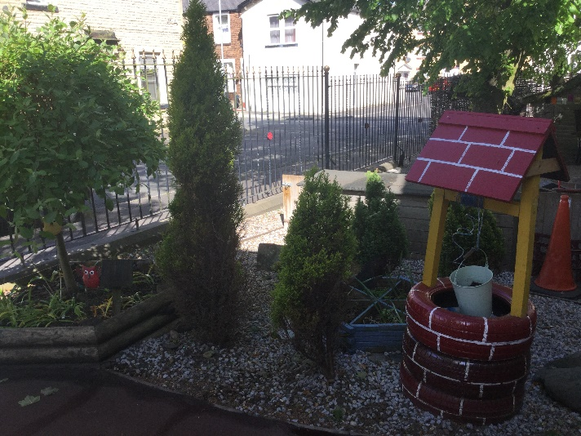
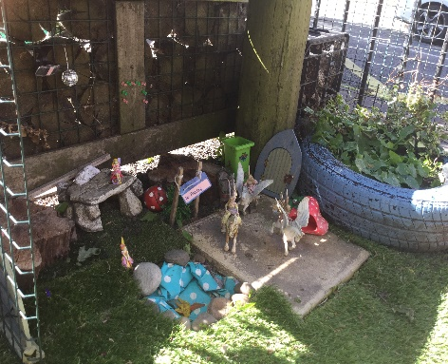
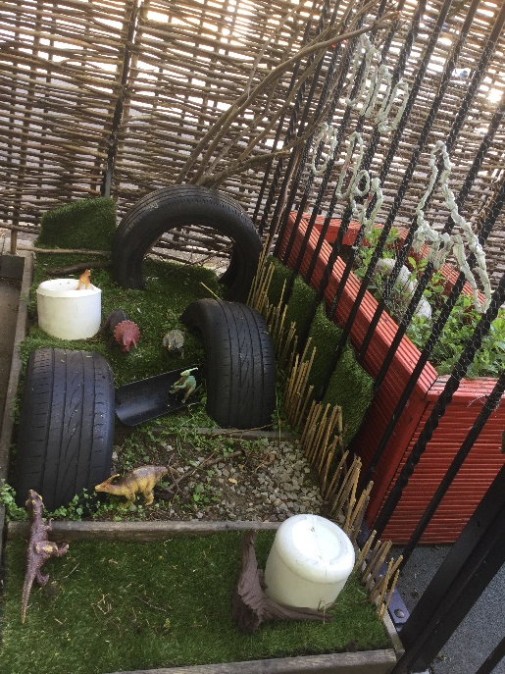
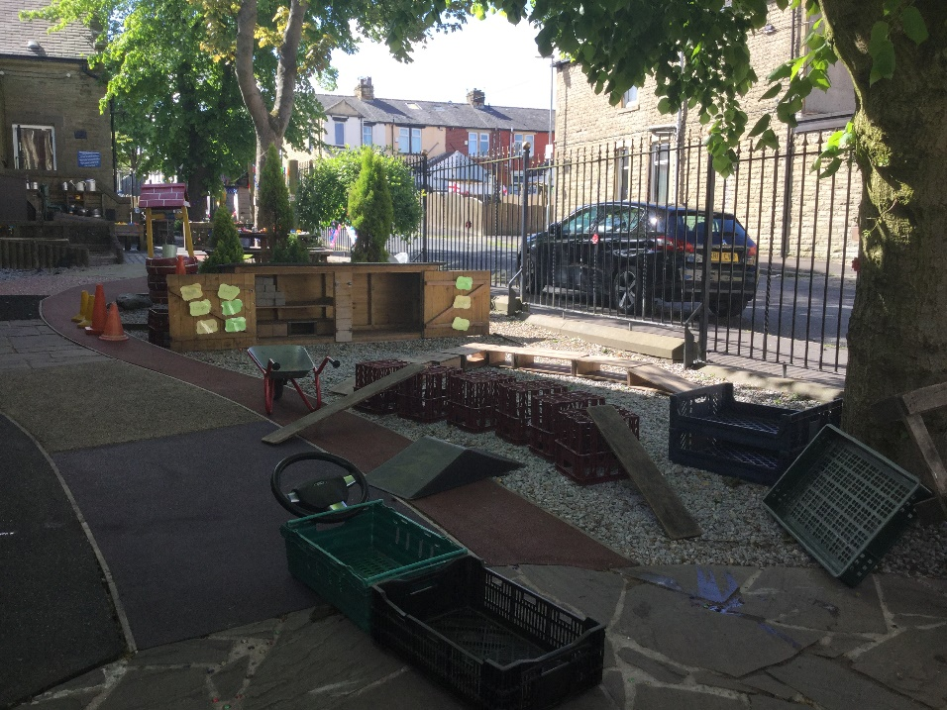
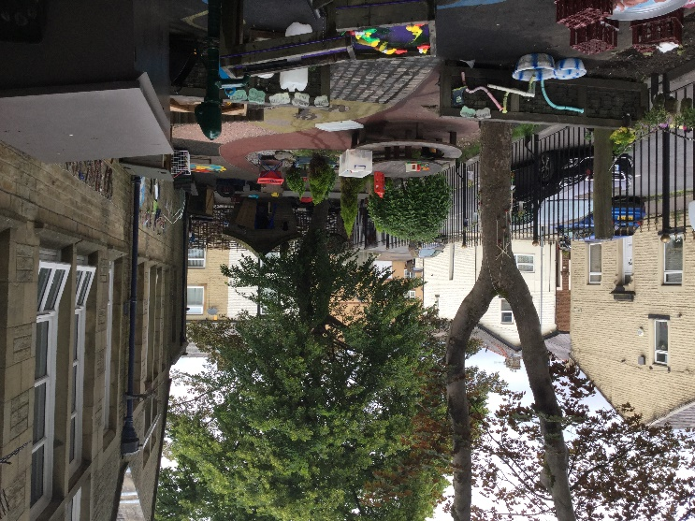
Our Outdoor Environment

Slide 8
How you can help your children to prepare for school:
Sing some nursery rhymes together.
Share stories together.
Count to 10 and practise counting objects.
Encourage them to get dressed/undressed by themselves.
Use a knife and fork to eat meals.
Teach them to put their own coat on and fasten it, especially their new school coat.
Talk to them about school and answer any questions they have as best as you can, to reassure them.

Slide 9
We are really looking forward to meeting you all very soon.
If you have any questions please contact school.
Keep safe and take care!

