Slide 1

The Early Years Foundation Stage

Slide 2
What is the EYFS?
The EYFS is the stage of education for children from birth to the end of reception year.
It is based on the recognition that children learn best through play and active learning. It is developed around four themes that underpin the EYFS:
1. A unique Child- Observe what a child is learning
2. Positive Relationships- What adults can do
3. Enabling Environments- What adults could provide
4. Learning and Developing- Children’s achievements through the above

Slide 3
Areas of Learning
Personal, Social and Emotional Development
Communication and Language
Physical Development
Literacy
Mathematics
Understanding the World
Expressive Arts and Design

Slide 4
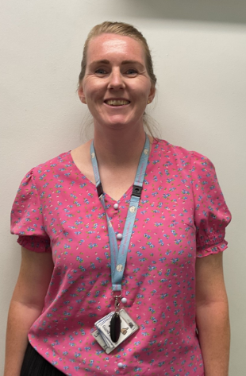
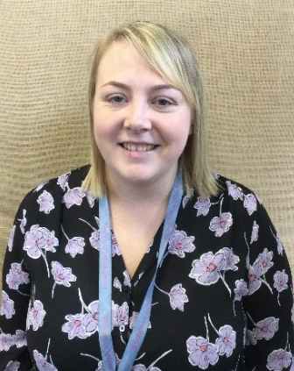
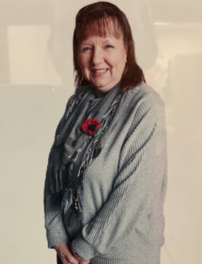
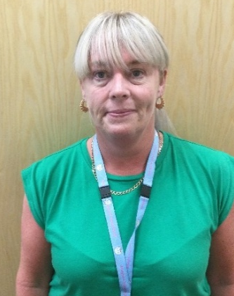
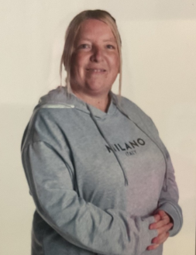
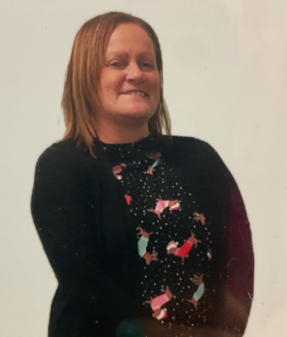
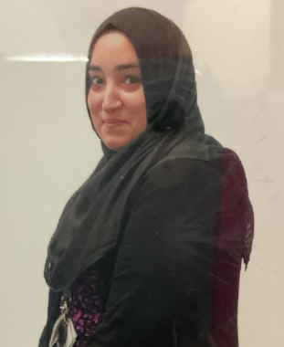
Meet the EYFS team
Miss Wilson
Co-Deputy Headteacher/EYFS Leader/Pearl class teacher
Mrs Hudson SENDCO/ Diamond Class Teacher
Miss Craig Teaching Assistant
Mrs Barlow HLTA
Miss Lupton Teaching Assistant
Miss Mitchell Teaching Assistant
Mrs Fatima Teaching Assistant

Slide 5
Key Person
Classes
Miss Wilson is Pearl class teacher. Mrs Hudson is Diamond class teacher.
Miss Craig, Miss Lupton, Mrs Barlow, Miss Mitchell and Mrs Fatima are our teaching assistants.
will respond to children’s needs and help them settle into school
communicate with parents/carers
keep a record of your child’s learning journey on Seesaw
plan activities based on the needs of each child
support your child in meeting their personal learning targets

Slide 6
Drop off and pick up times
Our school day starts at 8:45am promptly. Reception gate opens at 8:42am.
School finishes at 3:15pm.
Your child will need to bring their school bag every day with their reading books in.
Weekend workouts are sent home every week and will let you know what your child has been learning in school that week. A short homework activity will be set and your child will share these each week with their Key Person group.
Our P.E. days are Wednesdays and Fridays for Pearl class and Mondays and Thursdays for Diamond class.

Slide 7
Daily activities that take place in reception
Welcome and self-registration
Key Person time
Phonics
Continuous Provision with focus activities
Maths/Literacy directed group work
Story time/Music time
Home time

Slide 8
What you can do to help your child be school ready
Share books together, talking about the pictures.
Practise counting at any time- climbing the stairs, fingers, toes, socks.
Give them opportunities to mark make by holding a pencil.
Sing some nursery rhymes together.
Encourage your child to use the toilet independently, wash their own hands, dress and undress and put on and fasten their own coats.
Play games which encourage sharing and turn taking.
Support them in using a knife and fork at mealtimes.
Help your child to remember their full name and when their birthday is.
Encourage your child to use eye contact when speaking and listening.
Talk with your child about the places they go and the things they see in the world around them.
Give your child time to run, jump, climb and play outdoors.

Slide 9
Thank you
We look forward to a happy partnership in your child’s first year at school and beyond.
Schools website:
www.rosegrove.lancs.sch.uk

